Slide 1

Portfolio of experience
Rob Burton – Service Designer

Slide 2
PROJECT HIGHLIGHTS:
RESEARCH & INSIGHT PRIORITISATION
CO-CREATION WORKSHOPS
JOURNEY MAPPING
PROTOTYPING
KPIs & RESULTS

Slide 3
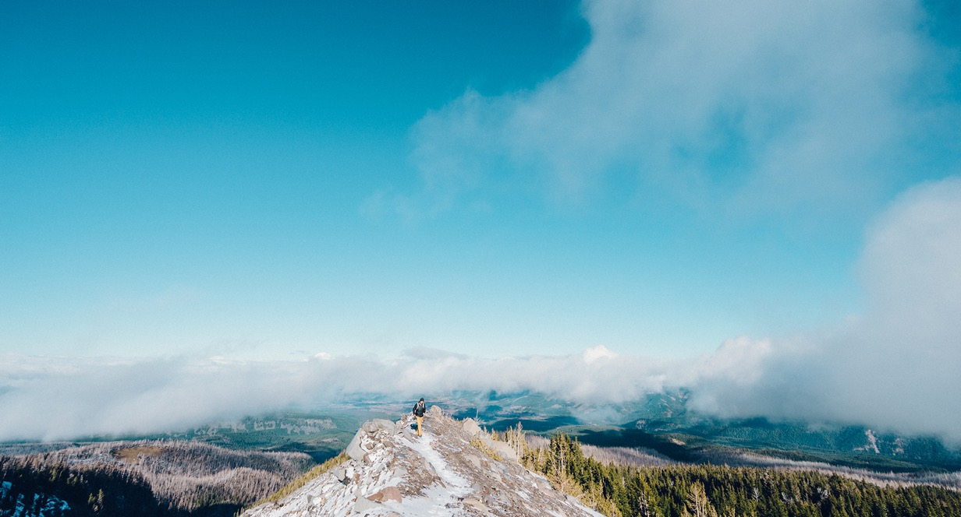
1
RESEARCH & INSIGHT

Slide 4


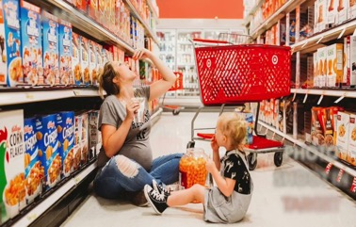
NESQUIK: RECRUITING FOR ETHNOGRAPHY. INTERVIEWS, QUESTIONNAIRES
Recruitment
Consumption
Shopping & Media Habits
DEMO’s & SCREENER
SCREENER QUESTIONS
*Demographics
(Gender, Age, Income, Employment status)
Mothers who have given their child a snack from the scope in the last week in order to participate
Attitudes to parenting & attitudes to kids consumption
2 OCCASION LOOPS
TOTAL 3000 Occasions of either of the categories in scope. Brand asked for Core and adjacent core categories
Context questions asked:
What
When
Where
Who With
Needs & Features
SHOPPING BEHAVIOUR
Shopping behaviour of anyone who had ever bought a core category (Flavoured milk – RTD, Flavoured Milk using powder, Flavoured milk using syrup)
Favourite brands, reasons for buying, often purchased from, substitution & Brand characteristics
MEDIA HABITS
Media usage, frequency, social media used etc

Slide 5
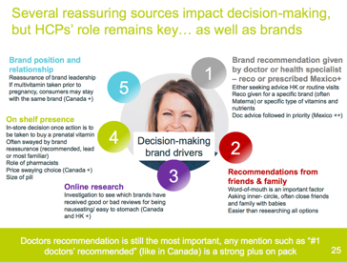
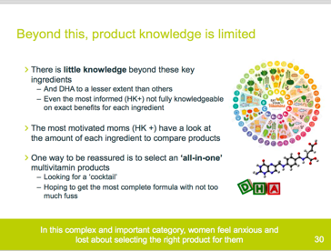

NESTLE INFANT NUTRITION: INSIGHT GATHERING & PRIORITISATION

Slide 6
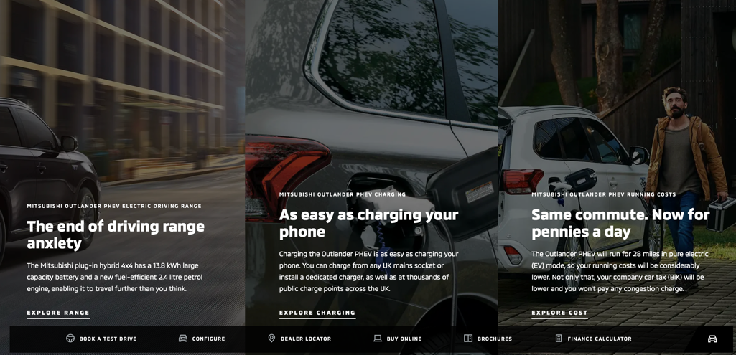
MITSUBISHI ELECTRIC VEHICLES: SYNTHESISING FINDINGS INTO ACTIONABLE SOLUTIONS

Slide 7
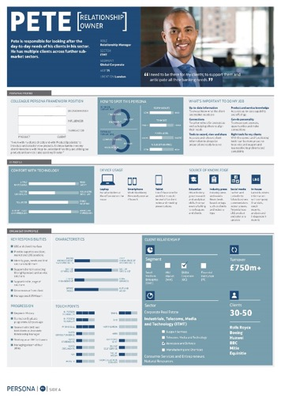
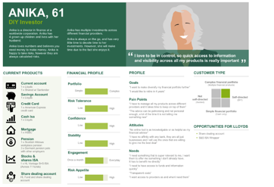
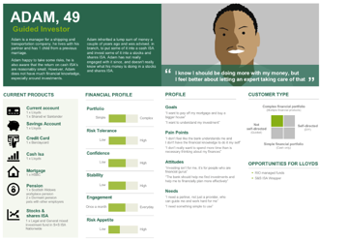
LLOYDS BANK: PERSONA CREATION: CUSTOMERS & INTERNAL STAKEHOLDERS

Slide 8
5
Co-CREATION WORKSHOPS

Slide 9
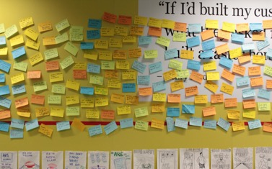
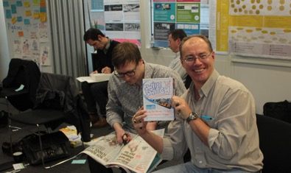
CO-CREATION WORKSHOPS – DIVERGENT THINKING: BRINGING IDEAS TO THE TABLE
Rapidly idea generation
Riff. Mash-up. Expand
Bringing ideas to life
Creating Ads, newspaper headlines, and cereal boxes

Slide 10
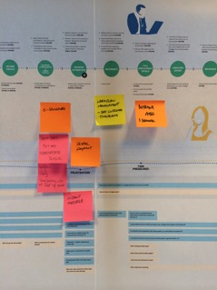
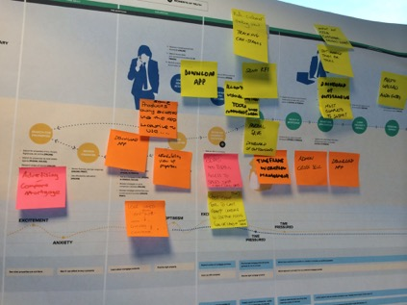
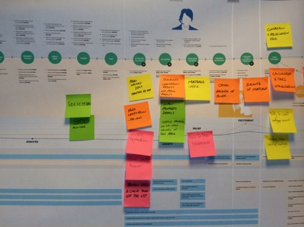
CO-CREATION WORKSHOPS – BT: OPPORTUNITY IDENTIFICATION AND THEMING

Slide 11
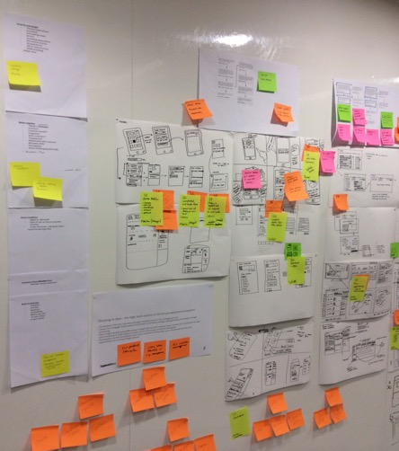
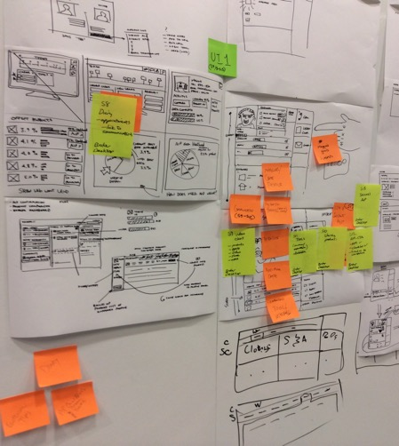
CO-CREATION WORKSHOPS – BT: CONCEPT SKETCHING

Slide 12
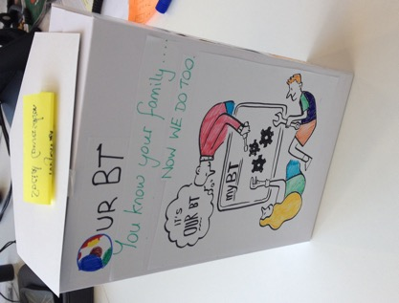
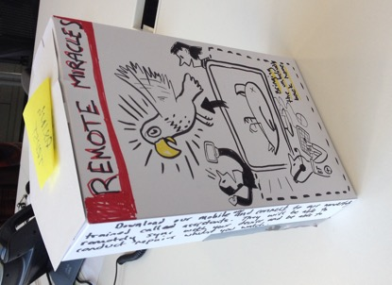
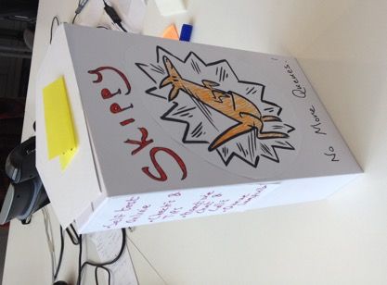
CO-C
CO-CREATION WORKSHOPS – BT: CONCEPTUAL PROTOTYPES

Slide 13
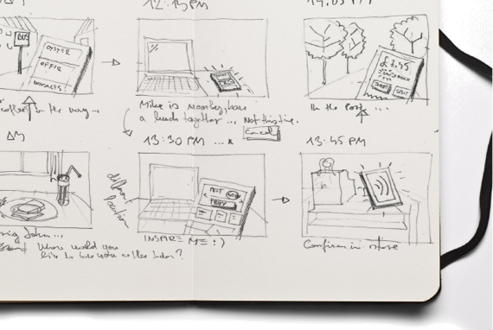
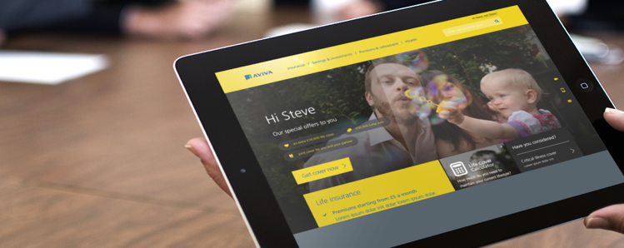
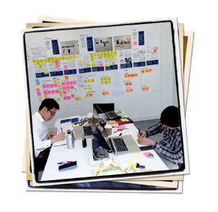
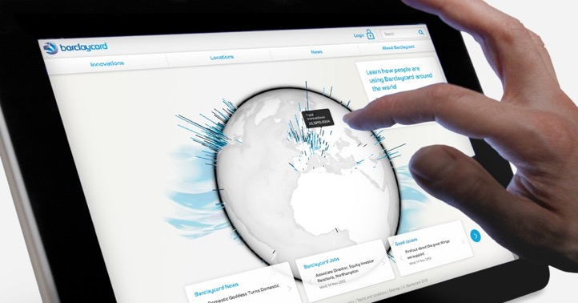
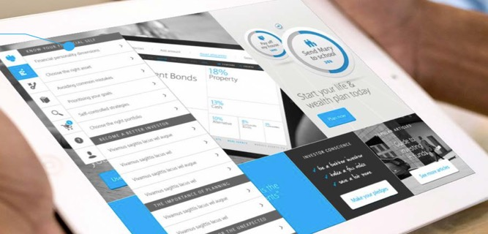
3
JOURNEY MAPPING

Slide 14
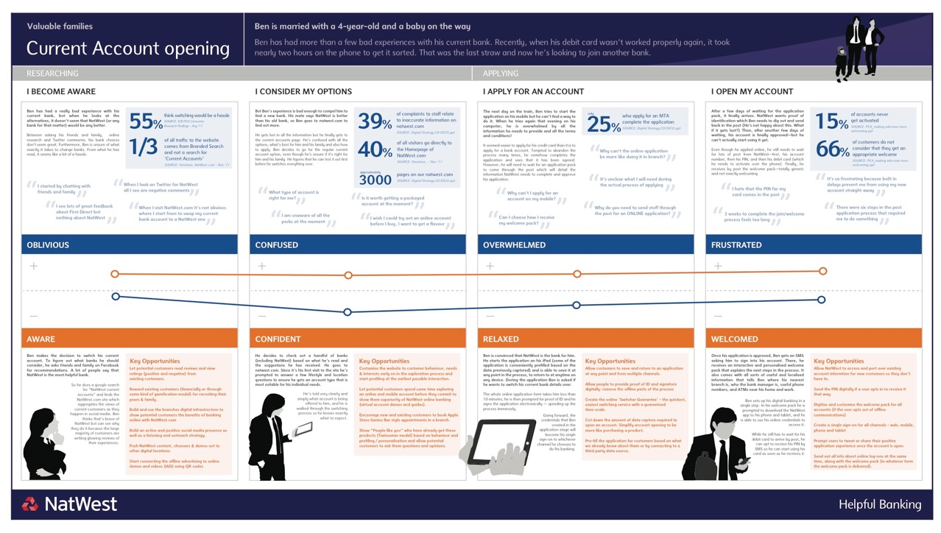
NATWEST: CURRENT ACCOUNT JOURNEY MAP

Slide 15
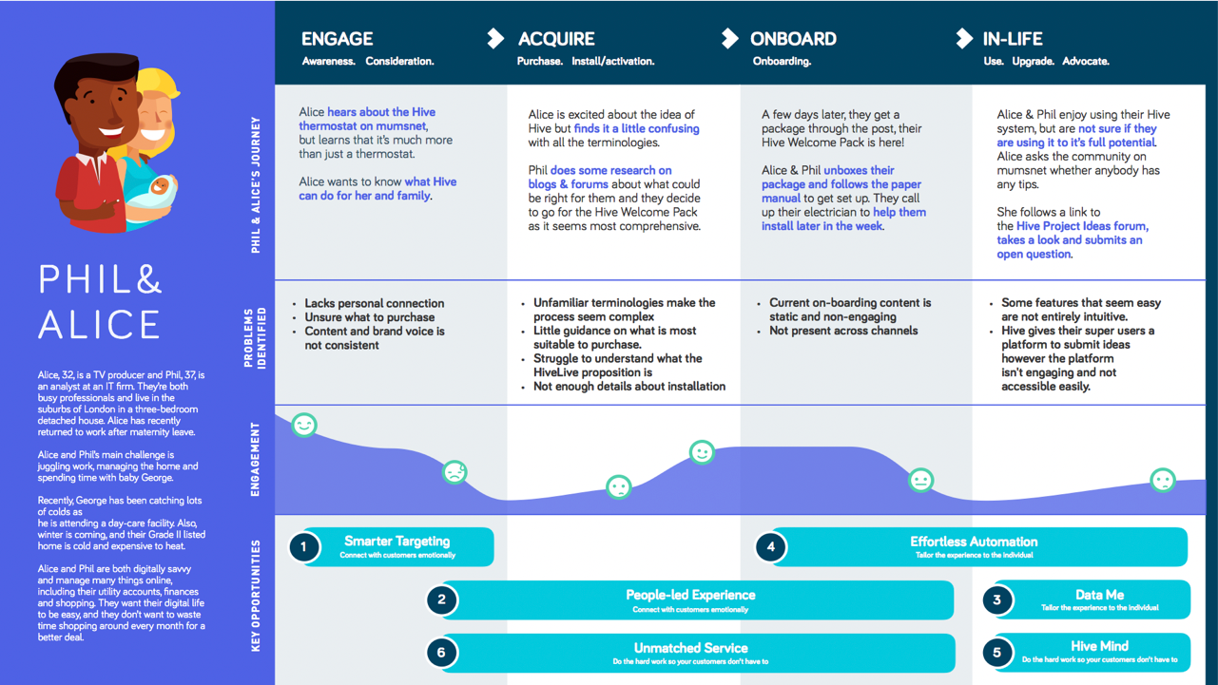
HIVE CONNECTED HOME: MAPPING POSSIBLITIES

Slide 16
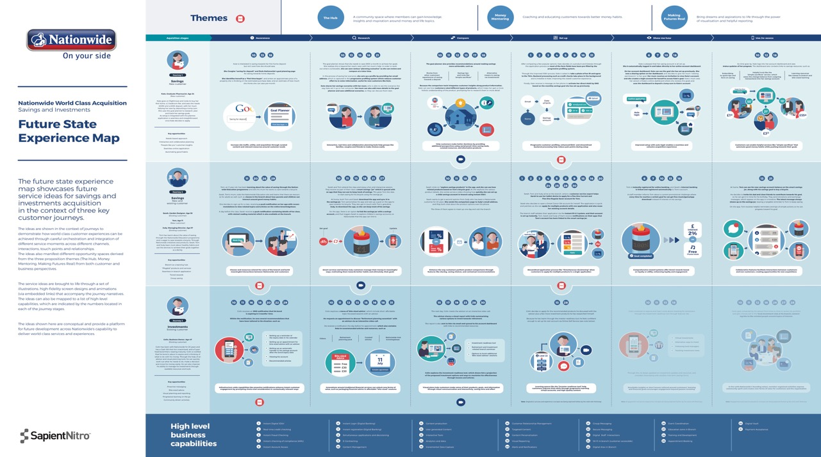
NATIONWIDE: FUTURE STATE MAPS

Slide 17
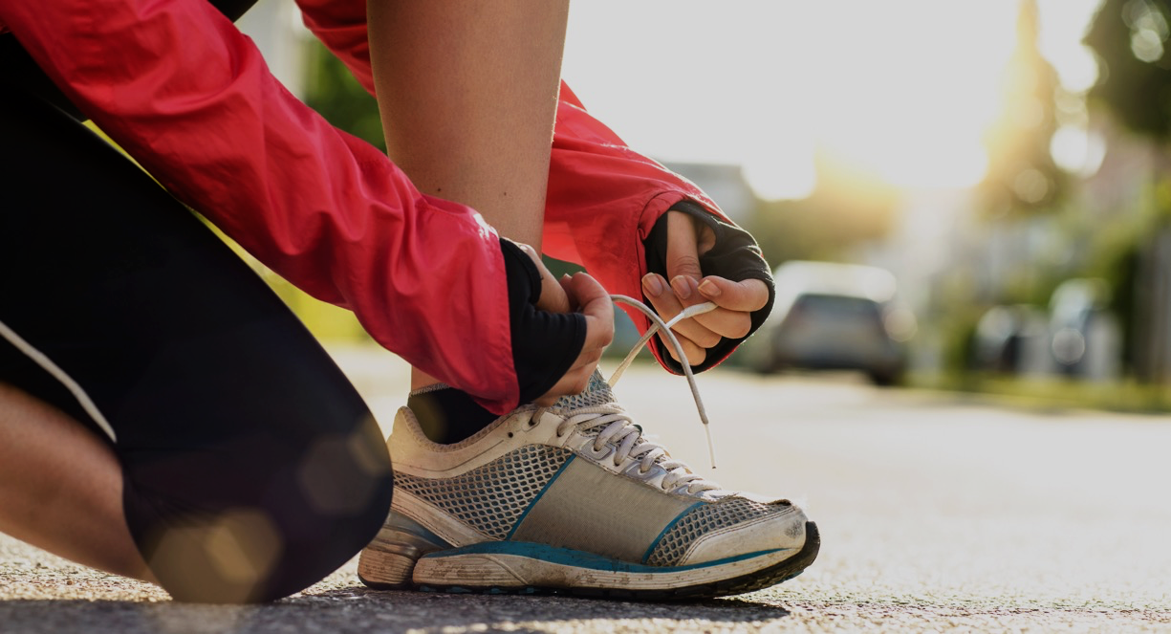
4
PROTOTYPING

Slide 18
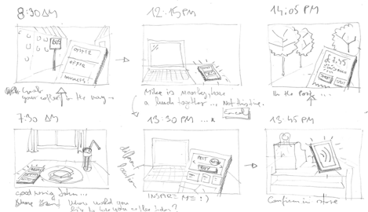
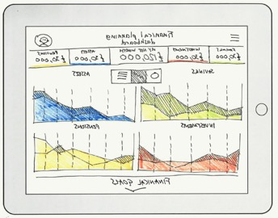
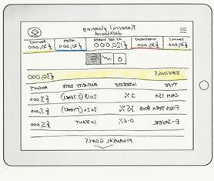
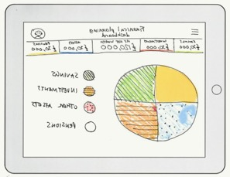
LLOYDS BANK: LO-FI PROTOTYPING - SKETCHING

Slide 19
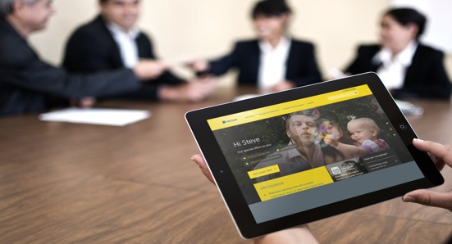
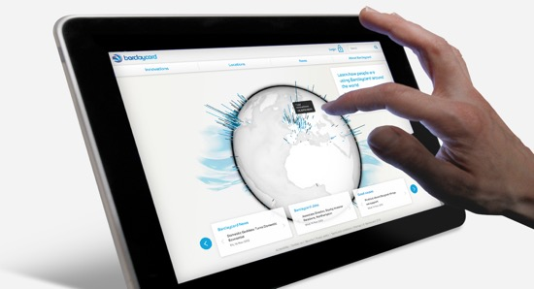
AVIVA : HI-FIDELITY PROTOTYPES

Slide 20
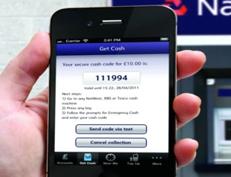
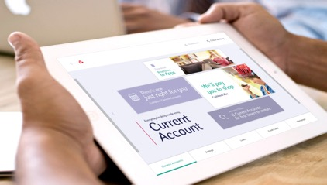
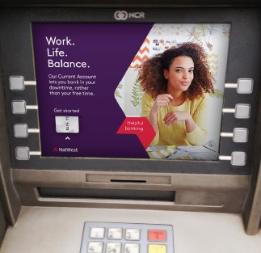
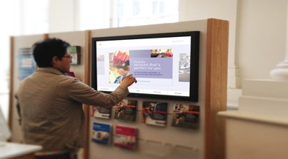
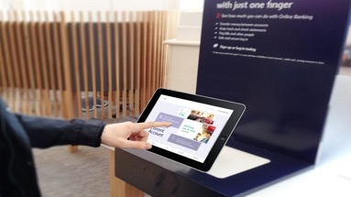
NATWEST : BUILDING CROSS-CHANNEL SOLUTIONS – MOBILE, TABLET, IN-BRANCH

Slide 21
5
KPIs & RESULTS

Slide 22
AVIVA : NEW APP CREATION RESULTS
METRICS (within 1st year)
Over 500,000 customer requests over £22 million claimed 17,000 requests per week
NPS IMPACT
From negative to positive in channel (laggard to leader)
Promoters significantly outnumber detractors
Ongoing improvement in switching levels / conversion
Ongoing costs savings
Digital experiences at the core of brand comms
RESULTS
40% of the target audience use it TWICE a month
X15 growth in use “helpfulness” of the service praised by customers

Slide 23
NATWEST : GET CASH
3 million downloads since launch
700 rescues in the first week of launch
170,000 rescues in the first year
No.1 in mobile in net promoter score
Busiest branch is online
GET CASH MOBILE APP
The RBS/NatWest app provides banking in your hands when you need it. It can rescue you when you have left your wallet at home or lost your debit card. A time sensitive six digit code will enable you to get cash from an ATM so you can get home safely.

Slide 24
LLOYDS : DIGITAL TRANSFORMATION
Savings Account Opening Journey
The average time for customer to open a Savings account in branch has gone down by 33%.
Personal Loan Journey
Overall credit acceptance and path to purchase increased by 40%
Corporate Pension Journey
We’ve reduced the time it takes corporate customers to update employee files from 21 days to 24 hours.
LLOYDS BANK
Lloyds went through a process of digital transformation, beginning with 10 key project journeys – the journeys - savings, pensions and loans - were immediately successful in driving KPIs enabling proof for the subsequent journeys.

Slide 25
THANK YOU

